Slide 1
AMPLIFY Yourself
Individual insurance advocacy
Awareness driving action
Community policy advocacy

Slide 2
AMPLIFY Initiative Overview
To address access to care challenges through:
Helping people write their insurer and legislators about their coverage needs
Use data to talk to insurers about coverage and policy
Build general awareness of community needs through sharing real-life stories
Notes:
The strategy is to address the insurance fairness issue in multiple ways – some new, some old – with stronger partnerships – while maintaining the unique patient voice

Slide 3
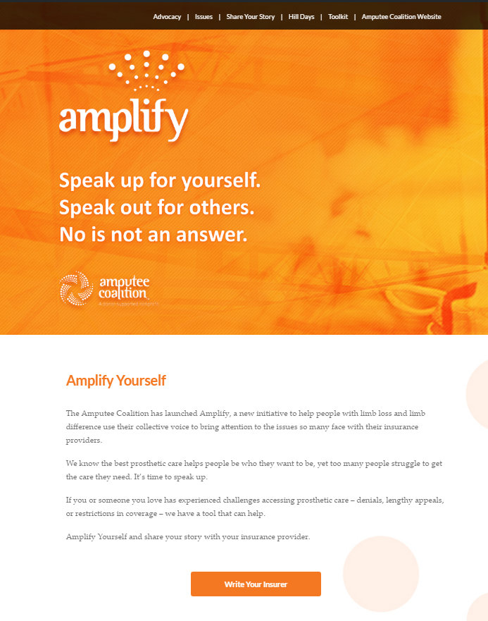
AmplifyYourself.org
“One stop shop” landing page
Insurance advocacy
Measurable
Connects to letter-writing tool
Notes:
The strategy is to address the insurance fairness issue in multiple ways – some new, some old – with stronger partnerships – while maintaining the unique patient voice.
We can measure and identify areas that recur, that happen multiple times – so even if a claim is older or a denial may not be reversed, it is important to be heard, and can make a difference through insurance or legislative policy change.
Your stories and information provide the foundation for conversations that demonstrate the negative impact that not getting the appropriate care can lead to.

Slide 4
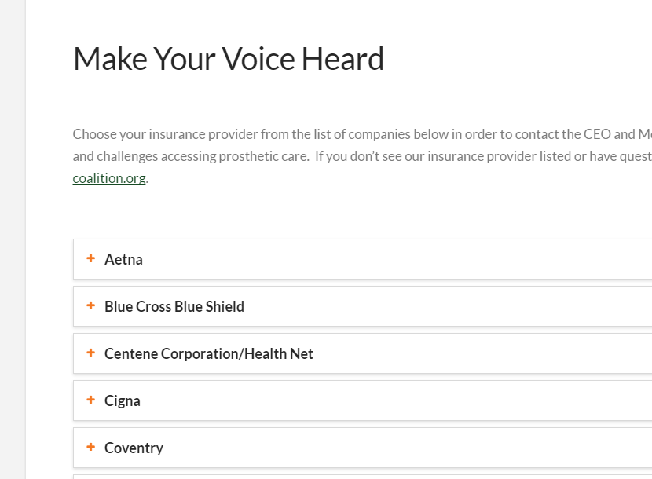
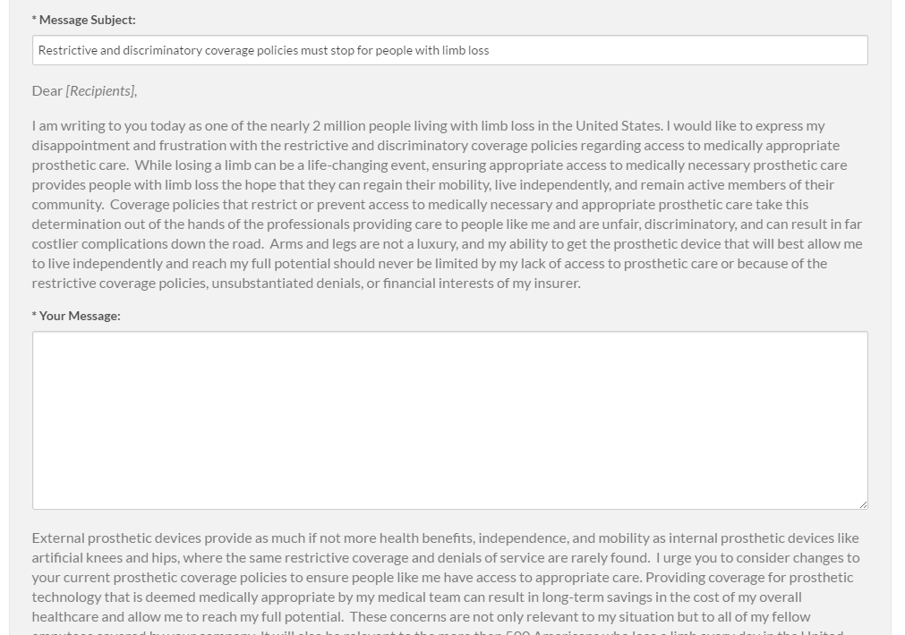
Insurance Advocacy
Select your insurer
Input your zip code
Add your story
Notes:
Once you click on write your insurer, you
Select your insurance company
Add your contact information to help identify the right President and Medical Director for your insurer (this can vary by state and zip code)
This information lets us pre-fill who the letters should go to.
Add your story to the insurance letter and consider sending the second letter to legislators for extra impact.
As you add your own personal details, share your story. Talk about what you may miss if you don’t get the care you need, or about what you will be able to accomplish with that care. Consider talking about the time it takes to fight for care, the impact on family, friends, career, and quality of life. Talk to your prosthetist for ideas, too. There may be certain phrases or activities that are important to highlight.

Slide 5
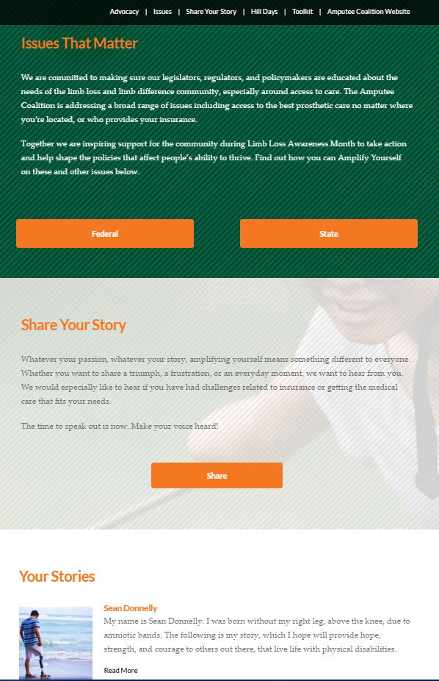
AmplifyYourself.org
Federal and state issues
Sharing your story
Story highlights
Notes:
We are keeping these areas updated based on current legislative topics – whether that is changing federal healthcare laws like the ACA or changes to the budget that could reduce funding for relevant research – our legislators listen when they hear from you!
And… Take a moment to have your patients share their stories – it can be about insurance coverage, or it can simply be their own experience. Hearing from real-life people, not just a 3 minute story on the news, helps the nation understand and support the needs of the limb loss community.

Slide 6
Your help: spread the word!
Ask people to use amplifyyourself.org
  Letter writing tools
  Share their story!
Share, like, and comment on Amplify social media
Print and share the flyer
  Questions? amplify@amputee-coalition.org

Slide 7
Notes:
Connects to the Amputee Coalition
Makes your voice heard!
Our identity – this links the campaign to us – font, color, language – while representing the purpose of amplify --
Exemplifies the ripples of telling a story
Some of you may have heard “Amplify your voice” – as we researched, it is already taken – including the website name – with a very different organization

Slide 8
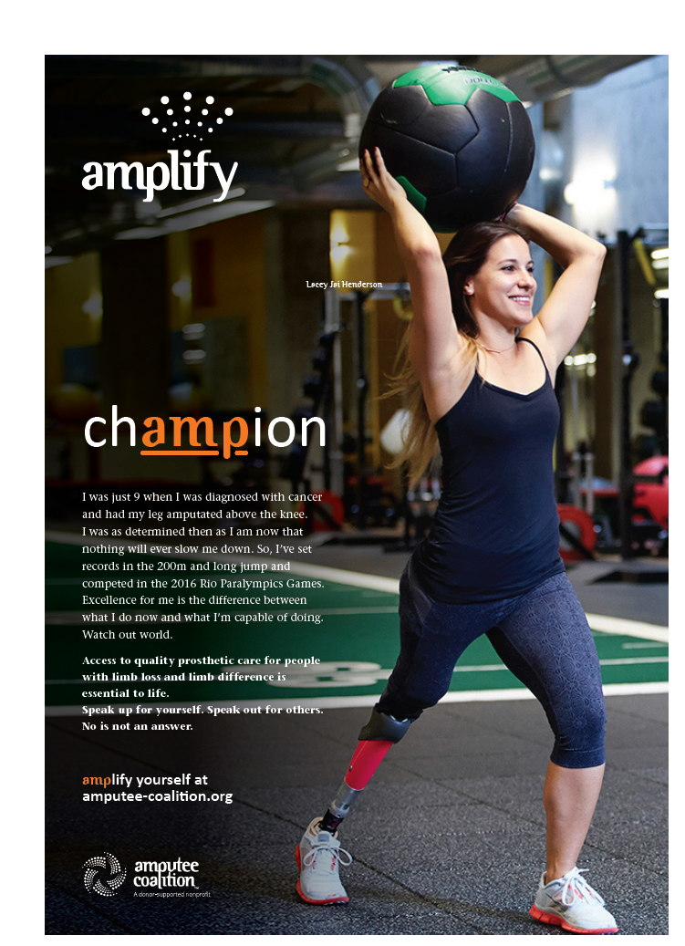
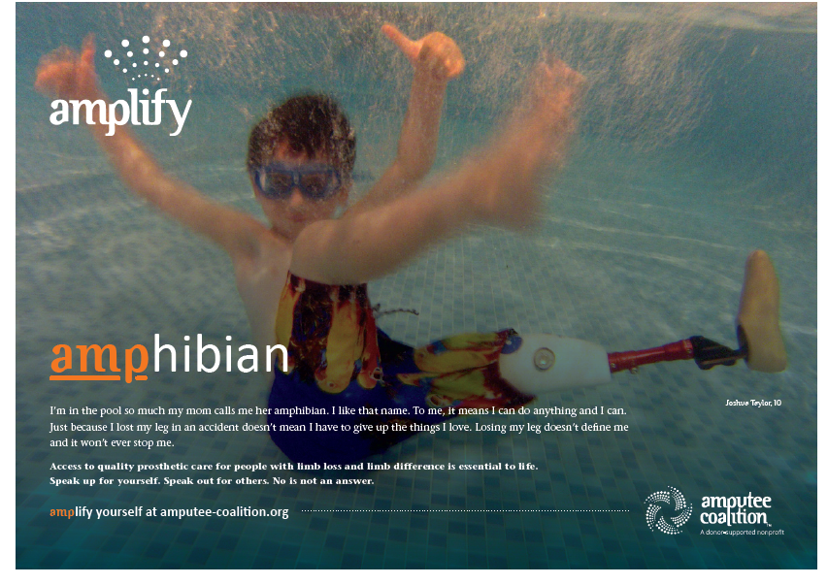
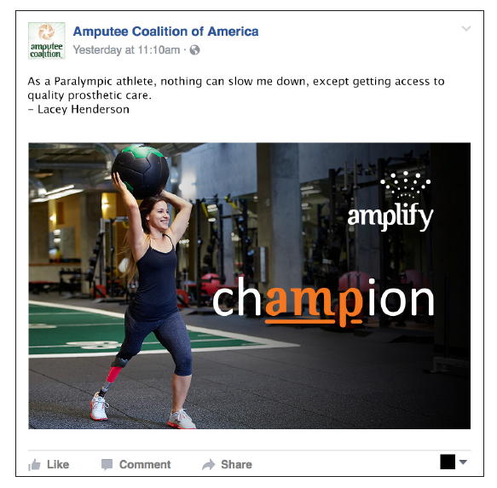
Notes:
Here is the look and feel of the campaign. We’re starting with people, with their voice and their story. We’re targeting large MSAs (and California) for the PR side, the home states of our targeted legislators. We will want to have several people that really exemplify the insurance struggle as a core, and then we want open floodgates for more stories! With that in mind, I will be sending you a form and a link to help us gather those, too…

Slide 9
March 2017
SUNDAY | MONDAY | TUESDAY | WEDNESDAY | THURSDAY | FRIDAY | SATURDAY
26 | 27 | 28 | 1 | 2 | 3 | 4
 |  |  |  | Amplify Campaign Design Standards issued
5 | 6 | 7 | 8 | 9 | 10 | 11
 | inMotion articles published: design refresh issue | Hill Day Email update | PR Key messaging draft for review |  | LLAM Month Calendar Published
12 | 13 | 14 | 15 | 16 | 17 | 18
 | CQ Engage: Gubernatorial Proclamation Campaign | Hill Day Email update | Hill Day Webinar | Begin LLAM pitches | AMPLIFY Promo Kit launched, "Strike Force" set
19 | 20 | 21 | 22 | 23 | 24 | 25
 | CQ Engage: Insurance Contacts Launch | Hill Day Email update |  |  | Strike force folloup | Website update scheduled
26 | 27 | 28 | 29 | 30 | 31 | 1
 |  | Hill Day Email update | Webinar: Telling Your Story |  | Strike force followup

Slide 10
April 2017 |  | Limb Loss Awareness Month
SUNDAY | MONDAY | TUESDAY | WEDNESDAY |  | THURSDAY | FRIDAY | SATURDAY
26 | 27 | 28 | 29 |  | 30 | 31 | 1
 |  | Hill Day Email update
2 | 3 | 4 |  | 5 | 6 | 7 | 8
 |  | Webinar: LLAM Highlights Hill Day Email Update
9 | 10 | 11 |  | 12 | 13 | 14 | 15
 |  | Hill Day Email update
16 | 17 | 18 |  | 19 | 20 | 21 | 22
 | Vermont Teddy Bear Launch | Hill Day Email update |  |  | Hill Day Email update |  | Hill Day Email update
23 | 24 | 25 |  | 26 | 27 | 28 | 29
 | Hill Day Email update | Hill Day |  | Hill Day |  |  | #ShowYourMettle!
30 | 1 | NOTES

Slide 11
What can you do?
You can turn up the volume!
Mention Hill Days and Amplify in your conversations
Engage with our posts
Share stories of success and struggles – we still want more!
Questions? Amplify@amputee-coalition.org

